Slide 1
Subject: | Life skills
GRADE | 3
TERM | 2

Slide 2
INSECTS | LISTENING AND SPEAKING
LIFE CYCLE | PHONICS
RECYCLING | READING AND VIEWING
KEEPING MY BODY SAFE | HANDWRITING

Slide 3
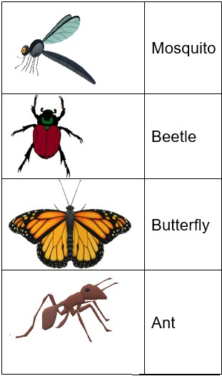
iNSECTS

Slide 4
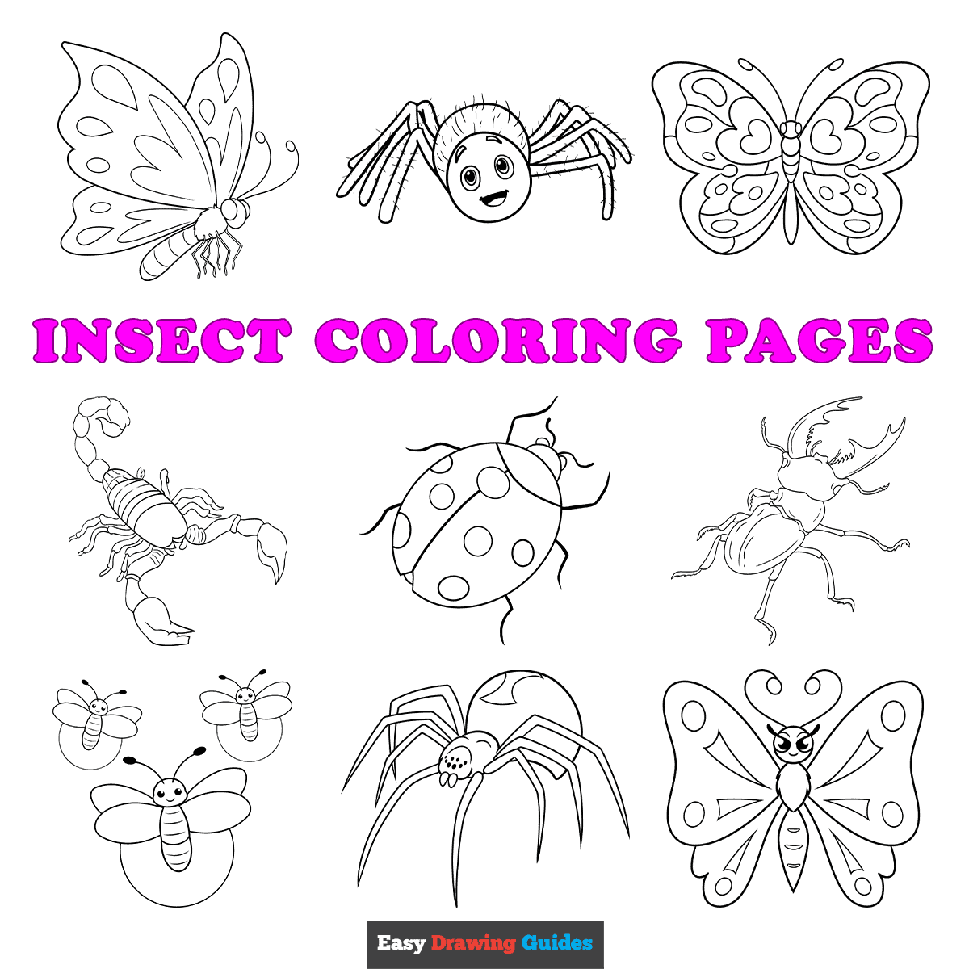
INSECTS
Learners are required to colour the insects
Group 1

Slide 5
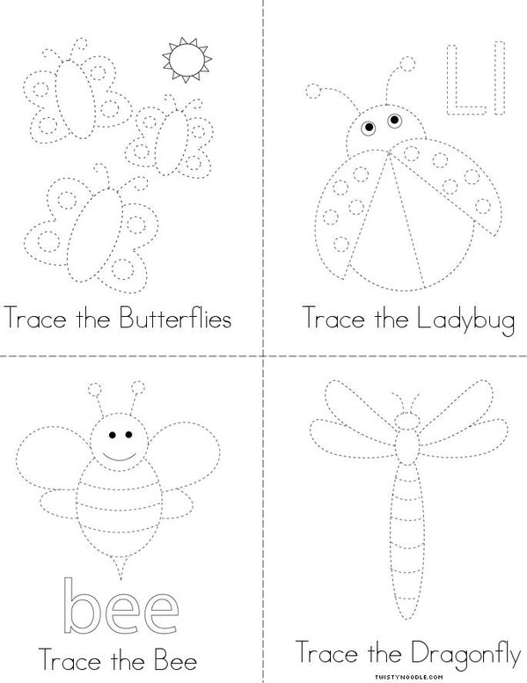
Insects
Group 2

Slide 6
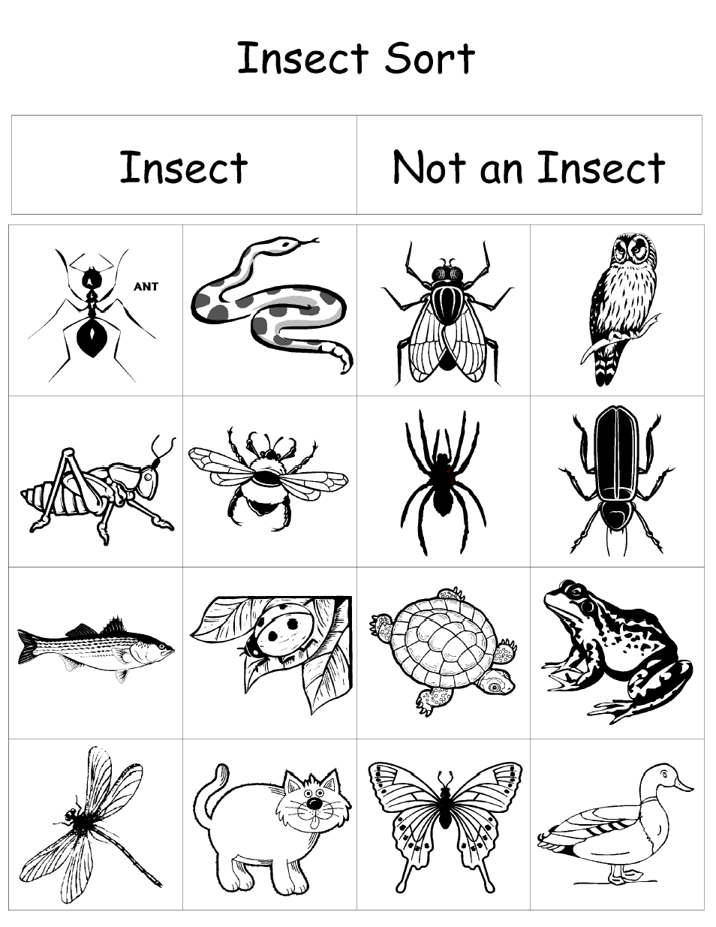
Insects
Group 3

Slide 7
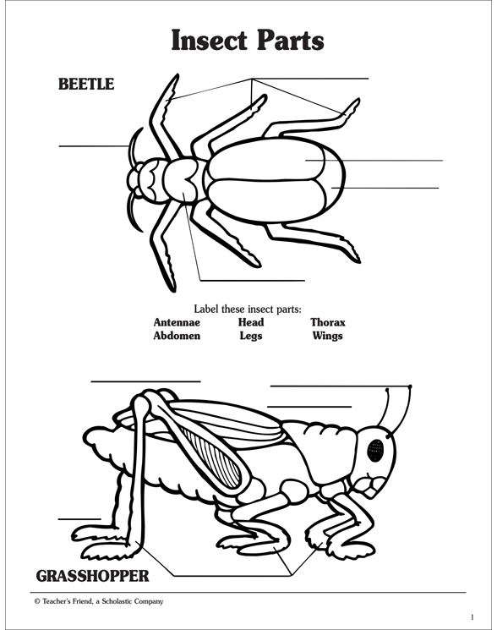
insects

Slide 8

Life cycle

Slide 9
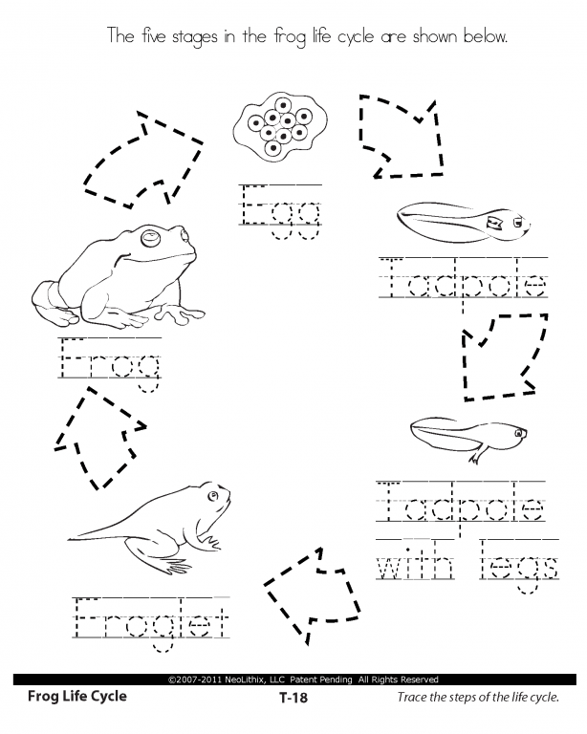
Life cycle
Group 1
Learners are required to trace the names of each stage below.

Slide 10
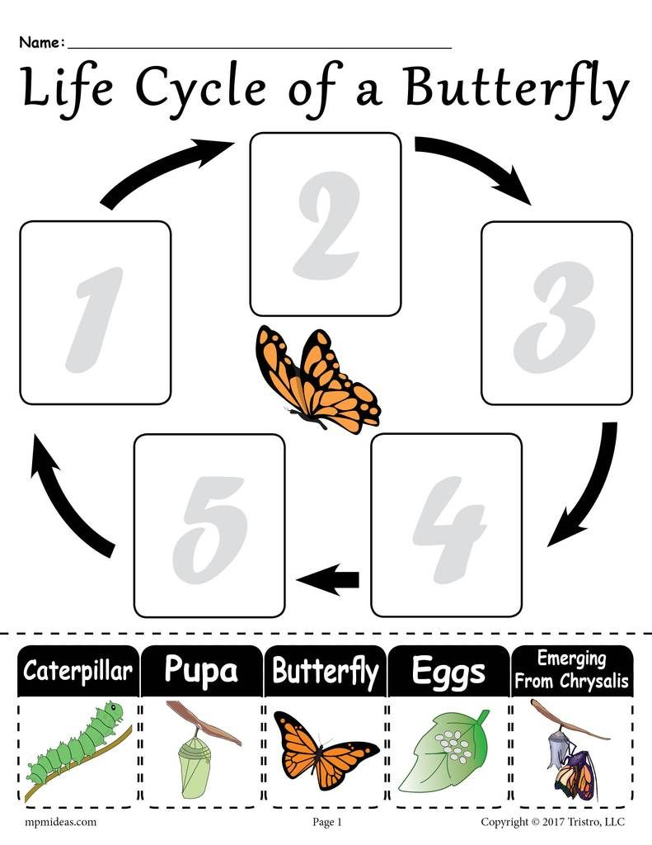
Life cycle
Learners must sort stages of growth accordingly.
Group 2

Slide 11
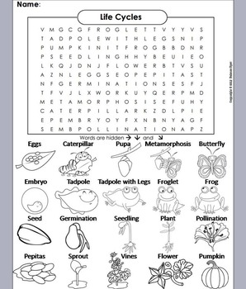
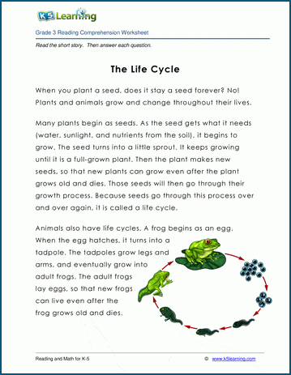
Life cycle
Group 3

Slide 12
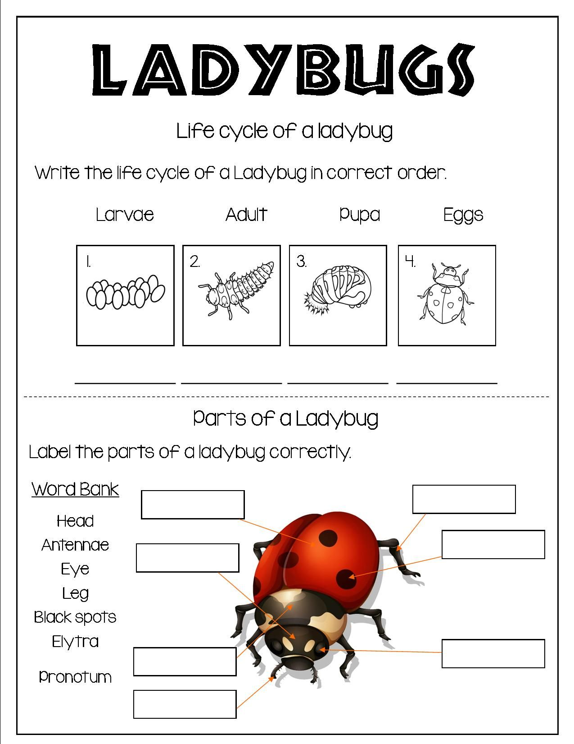
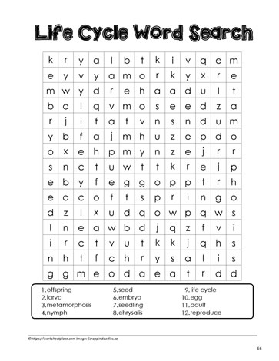
LIFE CYCLE

Slide 13

recycling

Slide 14
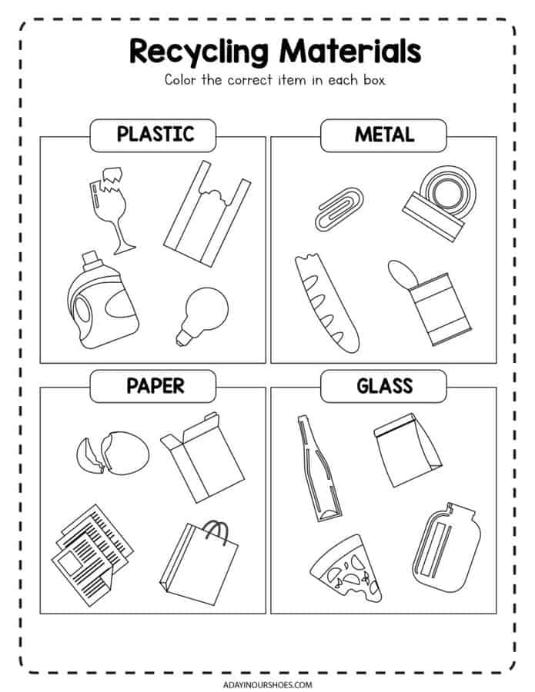
RECYCLING
Group 1

Slide 15
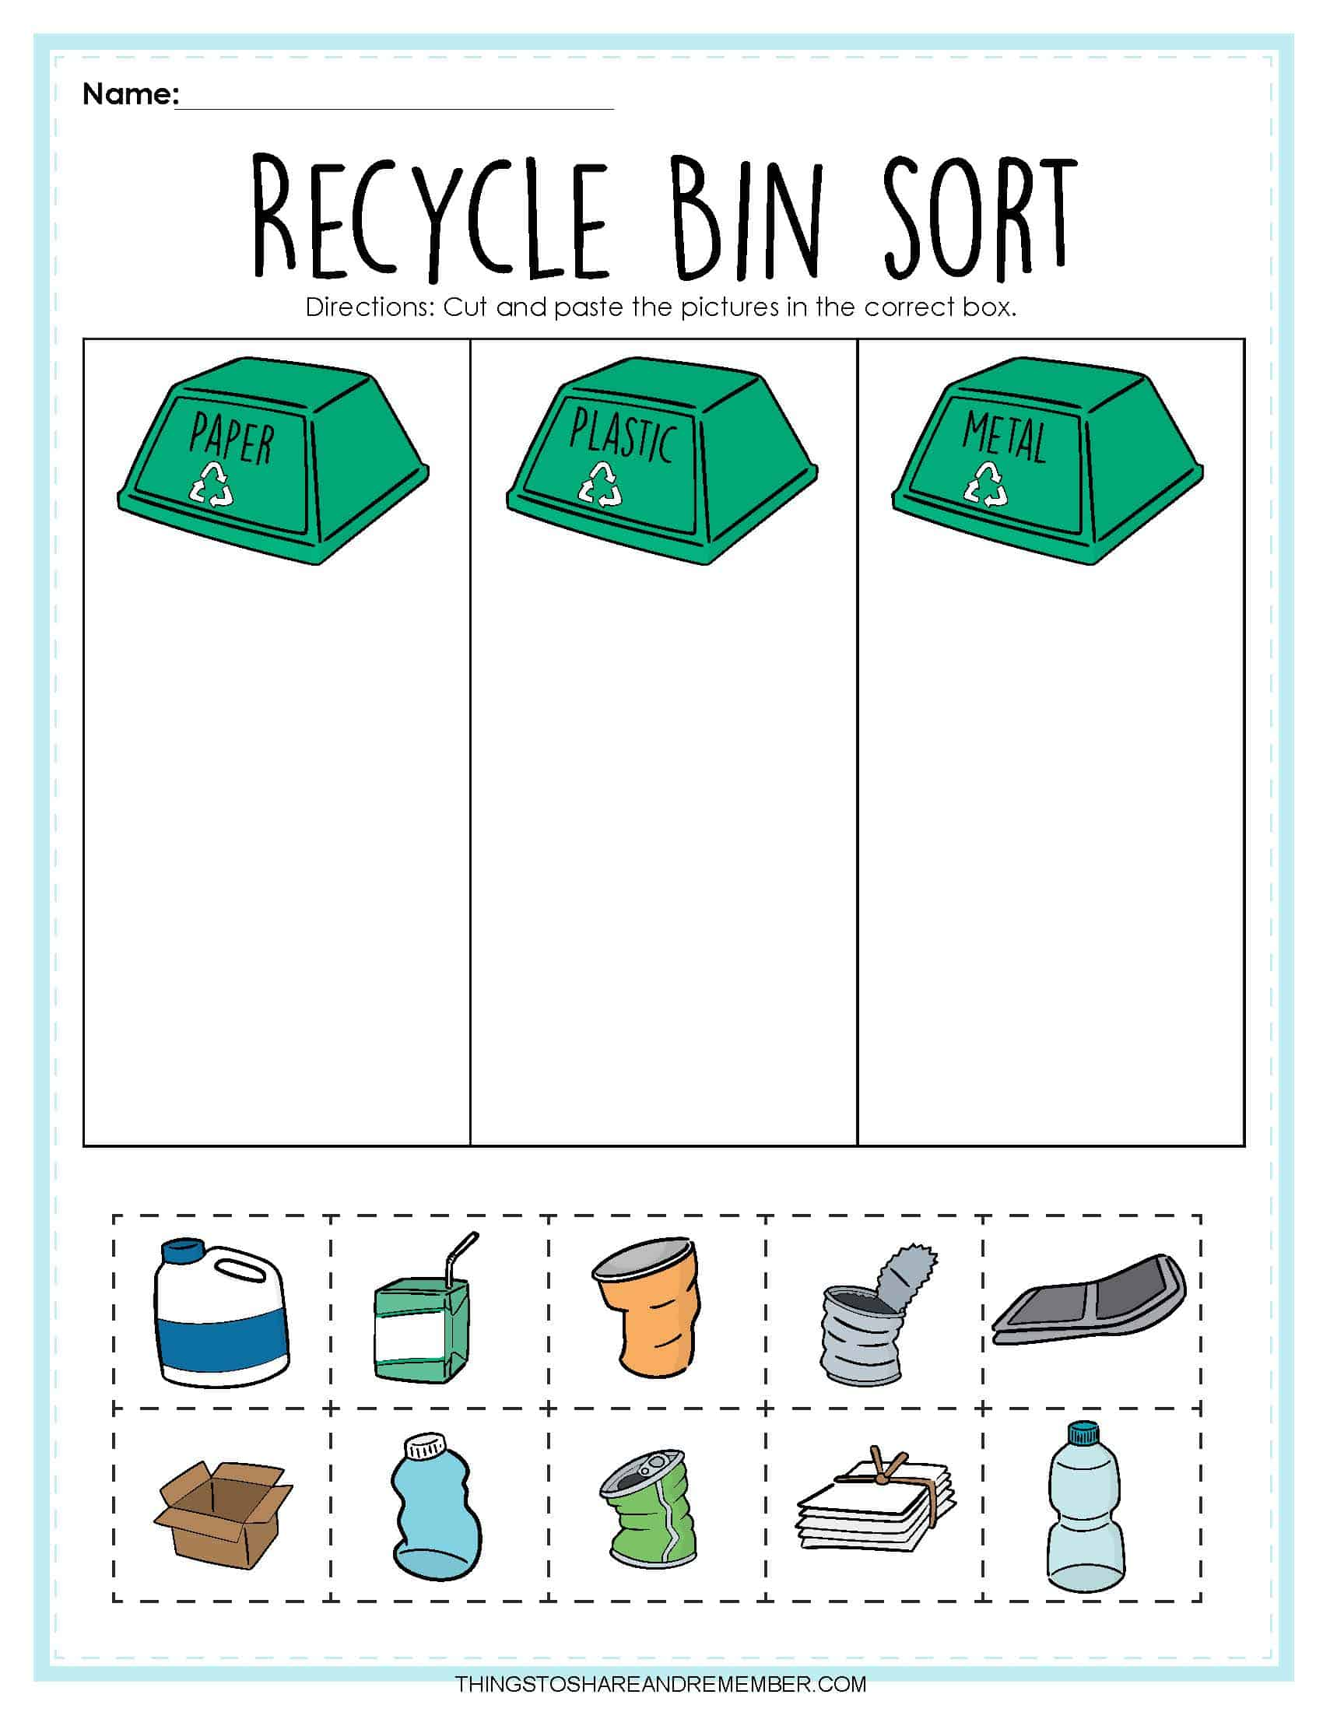
recycling
GROUP 2
Learners must sort the litter according to its material.

Slide 16
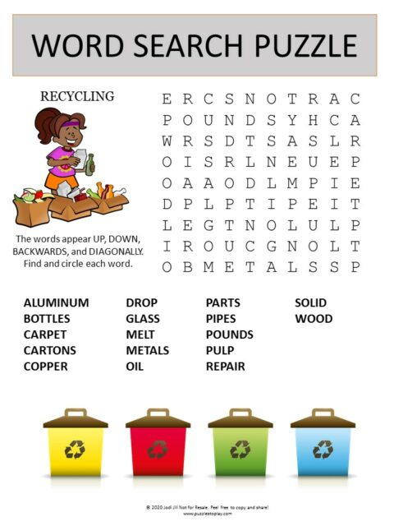
Life cycle
Group 2

Slide 17
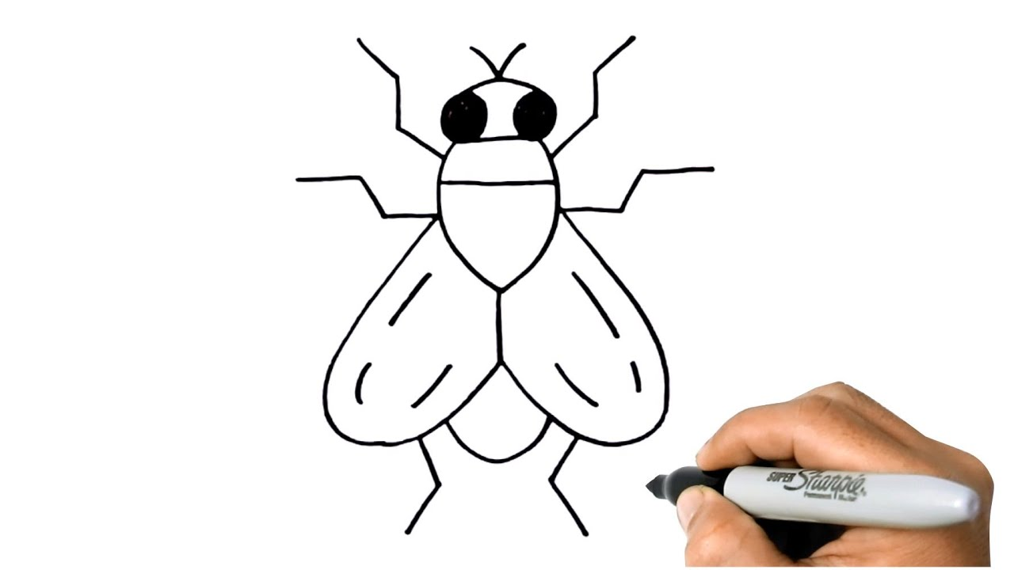
Life cycle
Group 3
Learners are required to draw the insect below.

Slide 18
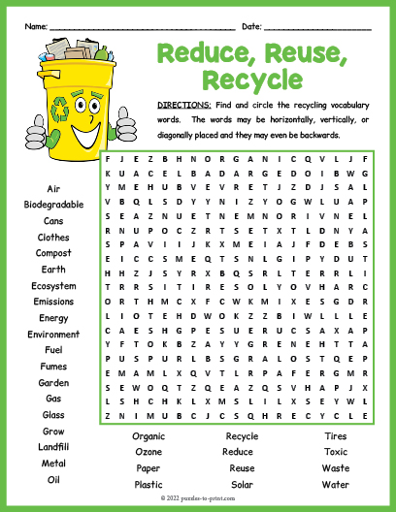
LIFE CYCLE
GROUP 3

Slide 19
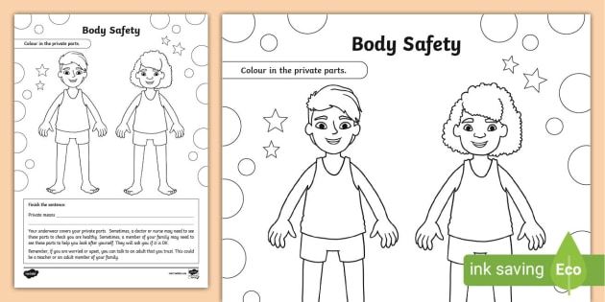
Keeping my body safe
Group 1/2/3
Learners are required to colour in the private parts of the body

Slide 20
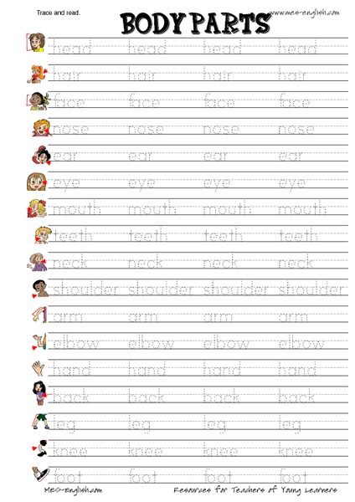
KEEPING MY BODY SAFE
Group 1

